Slide 1
Week 1 Class 1
Introduction

Slide 2
Course Goal
Autonomous navigation, guidance, and control of unmanned aerial vehicles
Focus: software algorithms

Slide 3
Course Content

Slide 4
Driverless Cars: Path Planner
Courtesy: Pieter Abbeel

Slide 5
Driverless Cars: Path Following
Courtesy: Pieter Abbeel

Slide 6
Driverless Cars: Unmanned Vehicle
Courtesy: Pieter Abbeel

Slide 7
Driverless Cars: State Estimation
Courtesy: Pieter Abbeel

Slide 8
Driverless Cars: State Estimation
Courtesy: Pieter Abbeel

Slide 9
Driverless Cars: State Estimation
Courtesy: Pieter Abbeel

Slide 10
Grading Policy
Bi-weekly homework (50%)
Project (50%)
Proposal (5%)
Literature review (5%)
Final report/presentation (40%)
Canvas: Discussions
Office Hour: 11:00 am – noon Tuesdays

Slide 11
Textbook and References
Textbook
No required textbook.
Main document: “Week_1 Beard Quadrotor Notes” (inside “Readings” folder)
Small Unmanned Aircraft: Theory and Practice, Princeton University Press, 2012 (http://uavbook.byu.edu/doku.php?id=start)
References
Handbook of Unmanned Aerial Vehicles, Springer, 2015. (free access for students)
Robotics, Vision and Control: Fundamental Algorithms in MATLAB, Springer, 2013. (free access for students)
Quad Rotorcraft Control: Vision-Based Hovering and Navigation, Springer, 2013.

Slide 12
Unmanned Aerial Systems (UAS)
A device used or intended to be used for flight in the air that has no onboard pilot. This includes all classes of airplanes, helicopters, airships, and translational lift aircraft that have no onboard pilot. Unmanned aircraft are understood to include only those aircraft controllable in three axes and therefore, exclude traditional balloons.
Federal Aviation Administration (2008)
A powered vehicle that does not carry a human operator, can be operated autonomously or remotely, can be expendable or recoverable, and can carry a lethal or nonlethal payload. Ballistic or semi-ballistic vehicles, cruise missiles, artillery projectiles, torpedoes, mines, satellites, and unattended sensors (with no form of propulsion) are not considered unmanned vehicles. Unmanned vehicles are the primary component of unmanned systems.
U.S. Department of Defense. Office of the Secretary of Defense (2007)

Slide 13
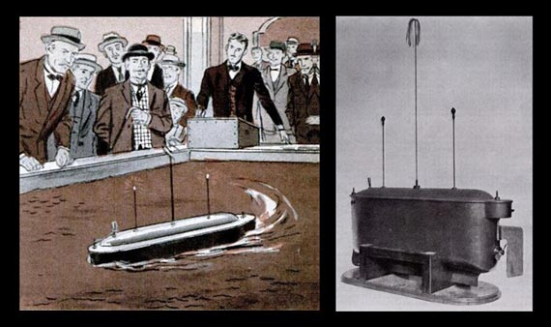
Unmanned Warfare
Nikola Tesla, Madison Square Garden, 1898

Slide 14
Aerial Target (pre-WWII)
DH.82B Queen Bee
“I could throw my bloody umbrella further than that!”
- Major Bell, British army office at an early drone demonstration in 1916

Slide 15
Torpedo Drone (WWII)
USAF Kettering Bug
(remotely controlled by television)
“To sit under the hood of an airplane and control the one up ahead with radar and television, where you can actually see where you are going – it felt like you are actually flying that plane.”
- A drone operator during WWII

Slide 16
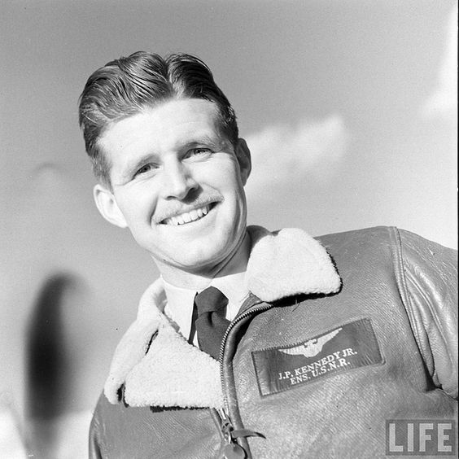
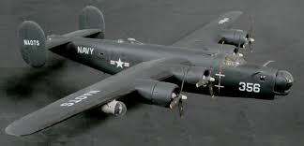
Radio-controlled Drone (WWII)
PB4Y-1 Liberator
Joseph P. Kennedy, Jr.

Slide 17
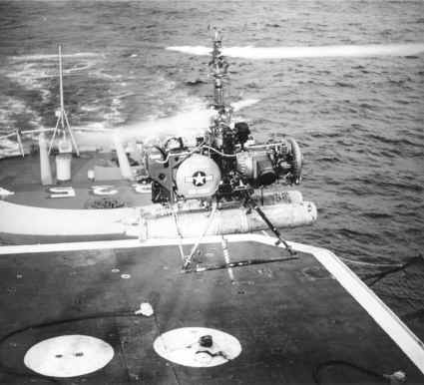
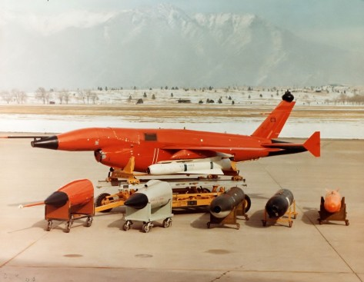
Reconnaissance and Armed UAVs (Vietnam War)
QH-50 DASH
(Anti-submarine helicopter)
Fire Fly

Slide 18
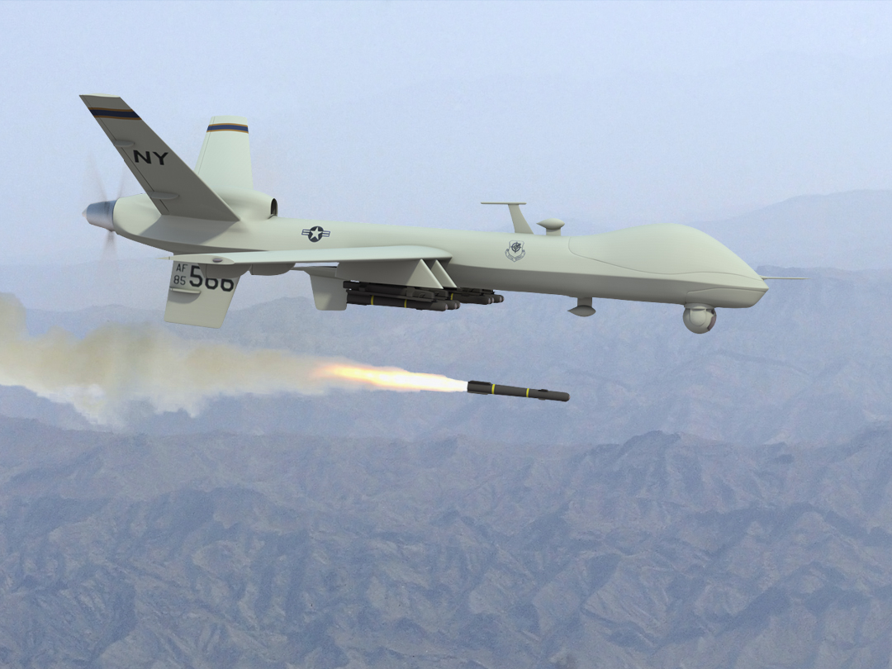
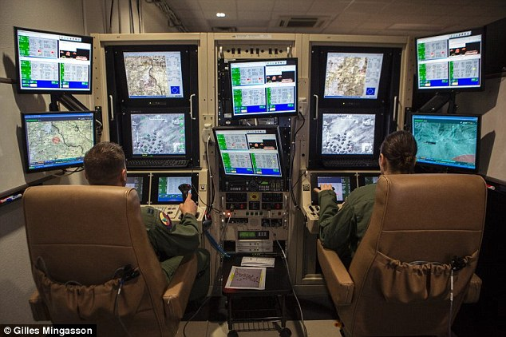
Predator UAVs (Bosnia, Iraq, Afghanistan)
Predator
UAV operators

Slide 19
Future?
Unmanned Systems Integrated Roadmap, DOD, 2013

Slide 20
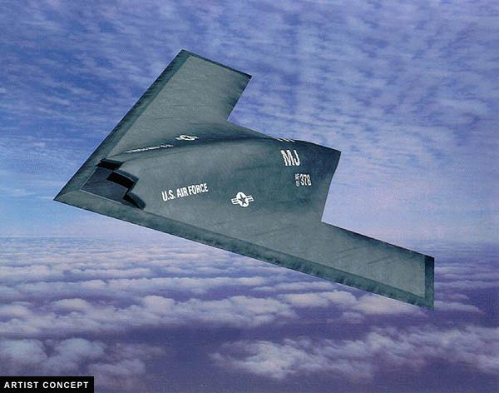
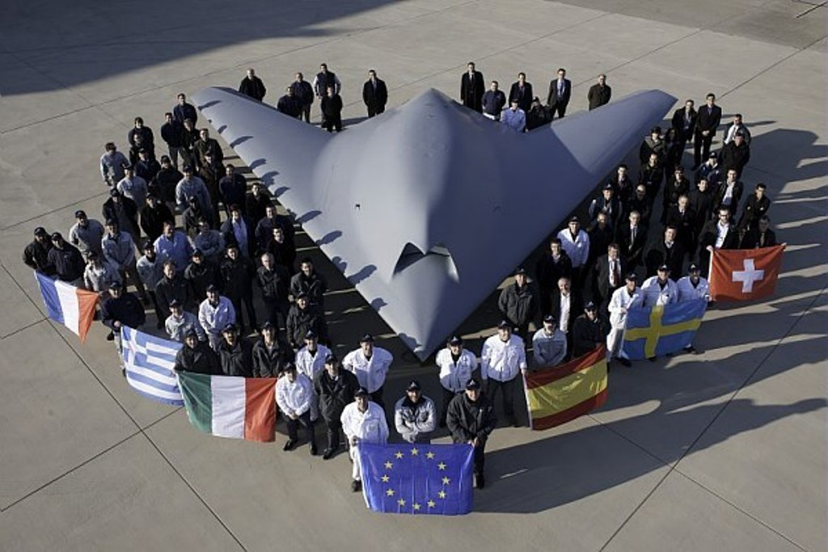
Unmanned Combat Aerial Vehicles (UCSVs)?

Slide 21
UAV Swarms?

Slide 22
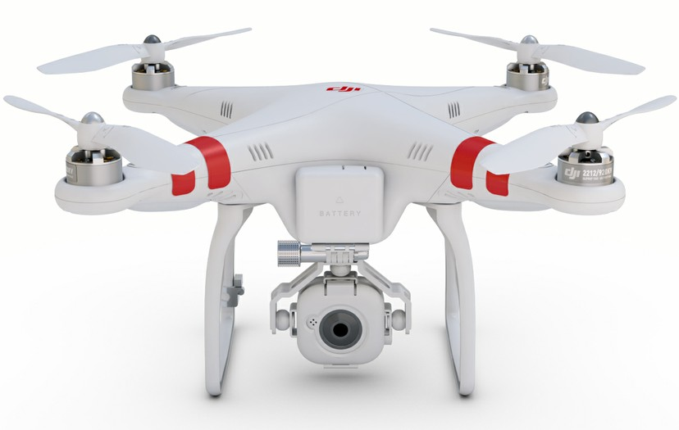
Small Aerial Vehicles
Attitude stabilization using MEMS sensors
Renaissance in the early 2000’s

Slide 23
Remote-Controlled Flight (2001-)

Slide 24
First-Person View

Slide 25
Autonomous UAS
With external positioning aid
GPS
2 Hz
3-5 m accuracy
Motion capture (indoor)
200-500 Hz
1 mm accuracy

Slide 26
Aggressive Flight Maneuvers
Daniel Mellinger, Nathan Michael, and Vijay Kumar. Trajectory Generation and Control for Precise Aggressive Maneuvers with Quadrotors. International Journal of Robotics Research, Apr. 2012.

Slide 27
Quadcopter Ball Juggling
Mark Muller, Sergei Lupashin, and Raffaello D’Andrea, “Quadrocopter Ball Juggling”, IEEE/RSJ International Conference on Intelligent Robots and Systems, pp.5113–5120, 2011.

Slide 28
Flying Robot Dance

Slide 29
Micro Aerial Vehicles

Slide 30
Navigation with Onboard Sensors
External motion capture systems are unpractical
Is this also possible with onboard sensors
GPS
Laser scanners
Cameras
Kinect

Slide 31
Indoor Navigation with Kinect Sensor

Slide 32
DARPA Fast Lightweight Autonomy (FLA)

Slide 33
Civilian Applications
Search and Rescue

Slide 34
Civilian Applications
Bridge Inspection
Precision Agriculture

Slide 35
Civilian Applications
Transportations (Goods)
Courtesy: Amazon

Slide 36
Civilian Applications
Transportations (Humans)
Courtesy: Ehang

Slide 37
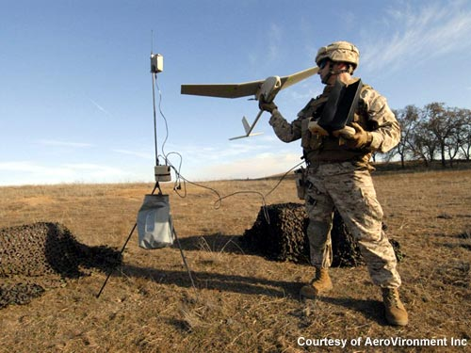
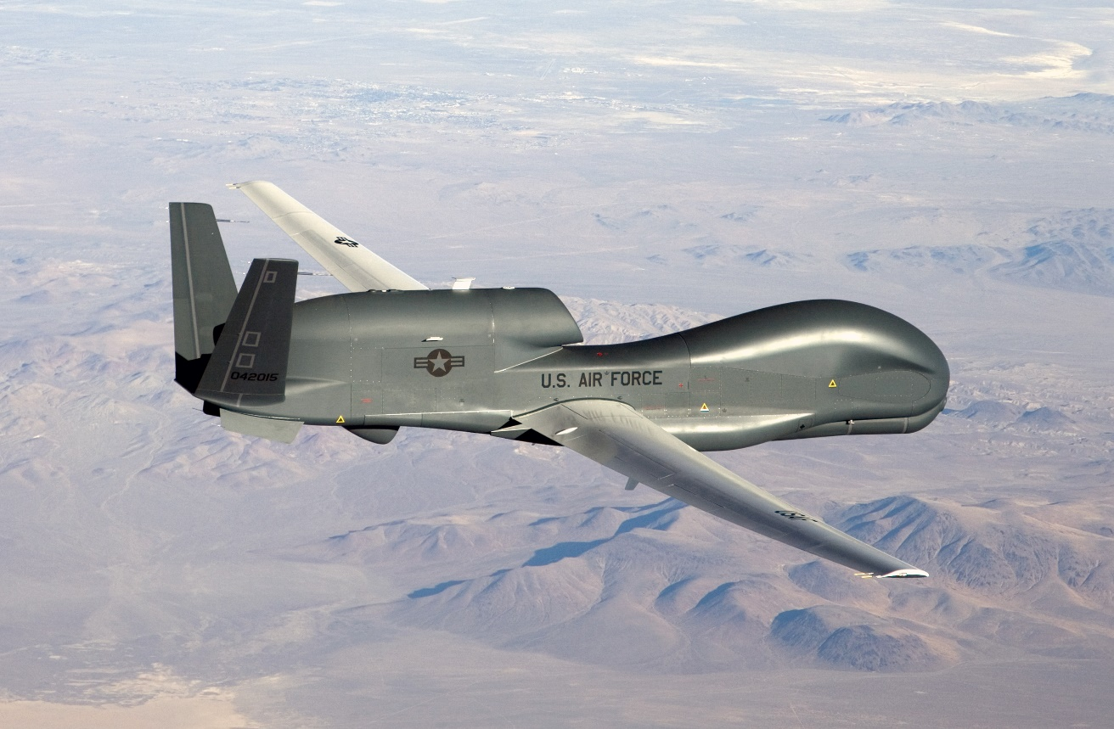
Military Applications
Reconnaissance, Surveillance and Target Acquisition
AeroVironment
Northrop Grumman

Slide 38
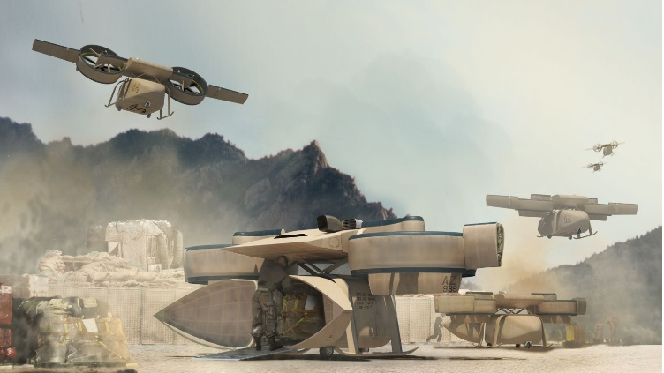
Military Applications
Transportations
Lockheed Martin

Slide 39
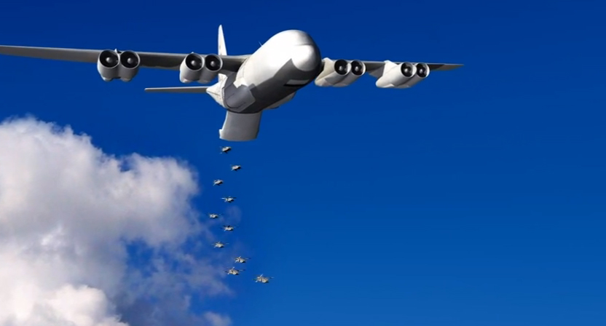
Military Applications
Combat
General Atomics
DARPA

Slide 40
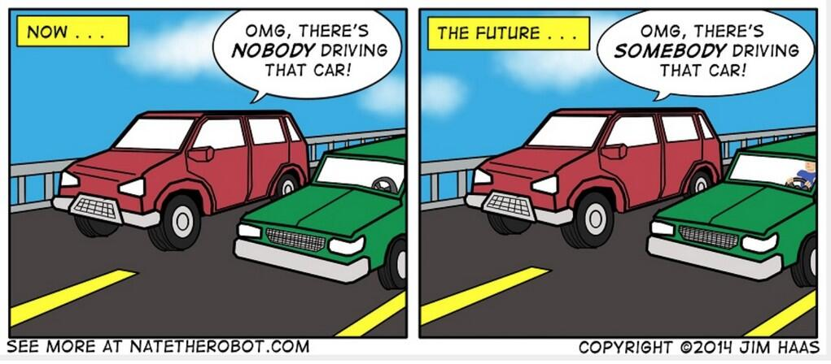
Public Acceptance
Majority vs. Minority

Slide 41
Ethical Considerations
“Human drivers may be forgiven for making an instinctive but nonetheless bad split-second decision, such as swerving into incoming traffic rather than the other way into a field. But programmers and designers of automated cars don’t have that luxury, since they do have the time to get it right and therefore bear more responsibility for bad outcomes.”
- Patrick Lin, The Atlantic

Slide 42
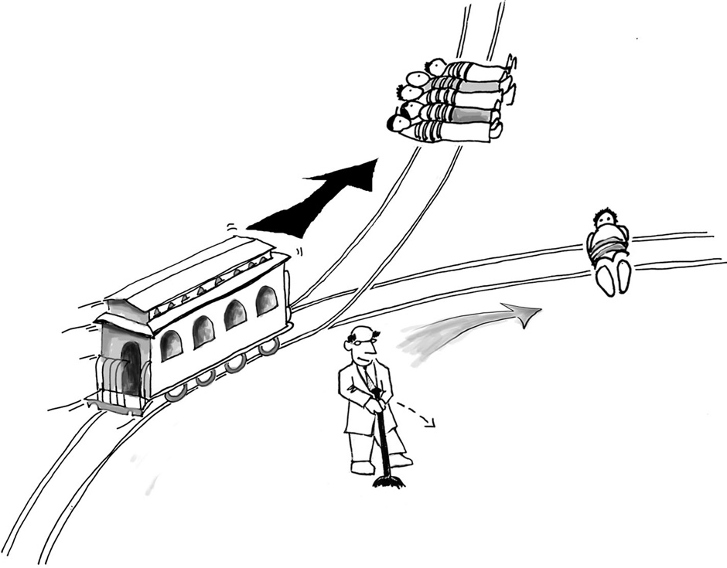
The Trolley Problem
A trolley’s brakes have failed.
You are controlling the signal switch.
If you do nothing, five people will be killed.
If you activate the switch, only one person will be killed.
What do you choose to do?
Critical distinction: Allowing death versus causing death?

Slide 43
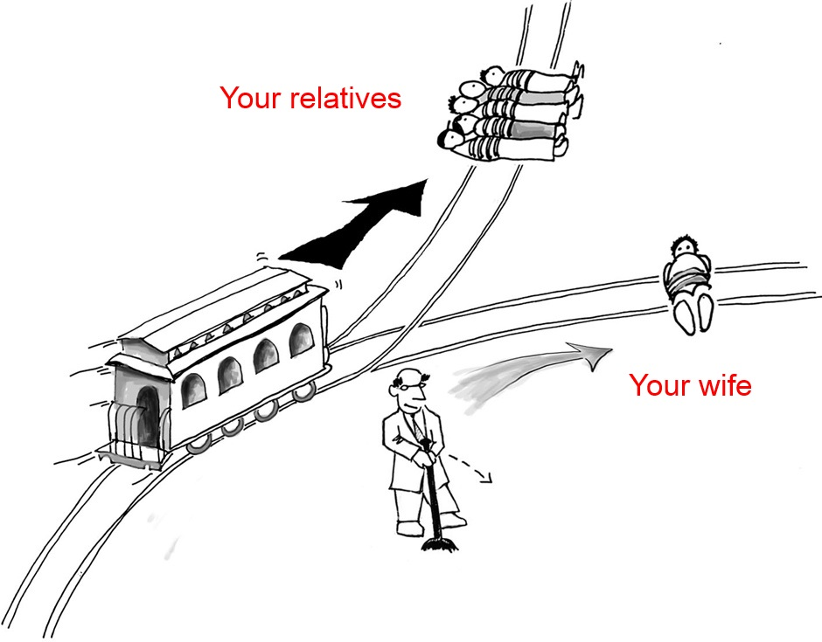
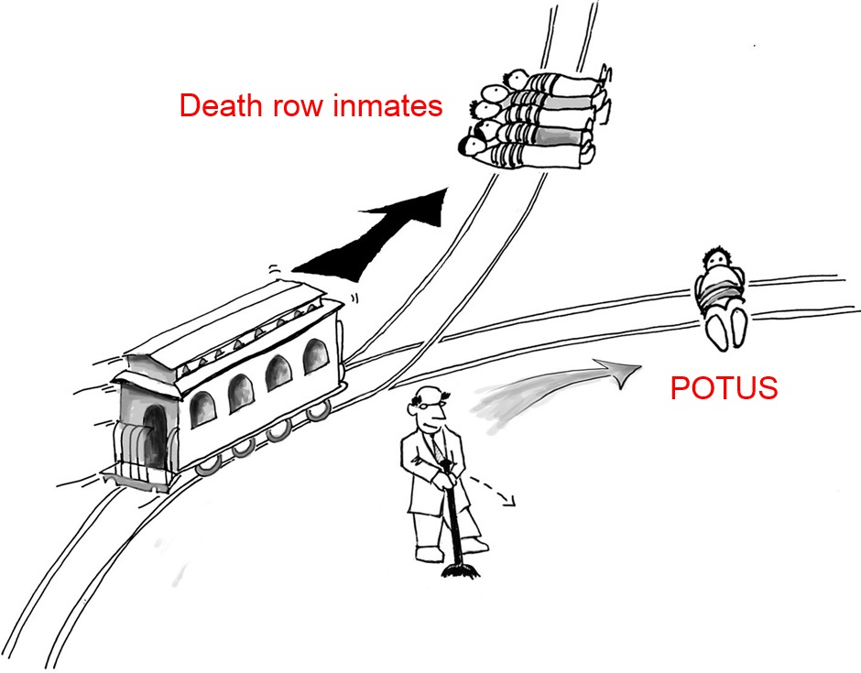
When the identities of the actors change

